Slide 1
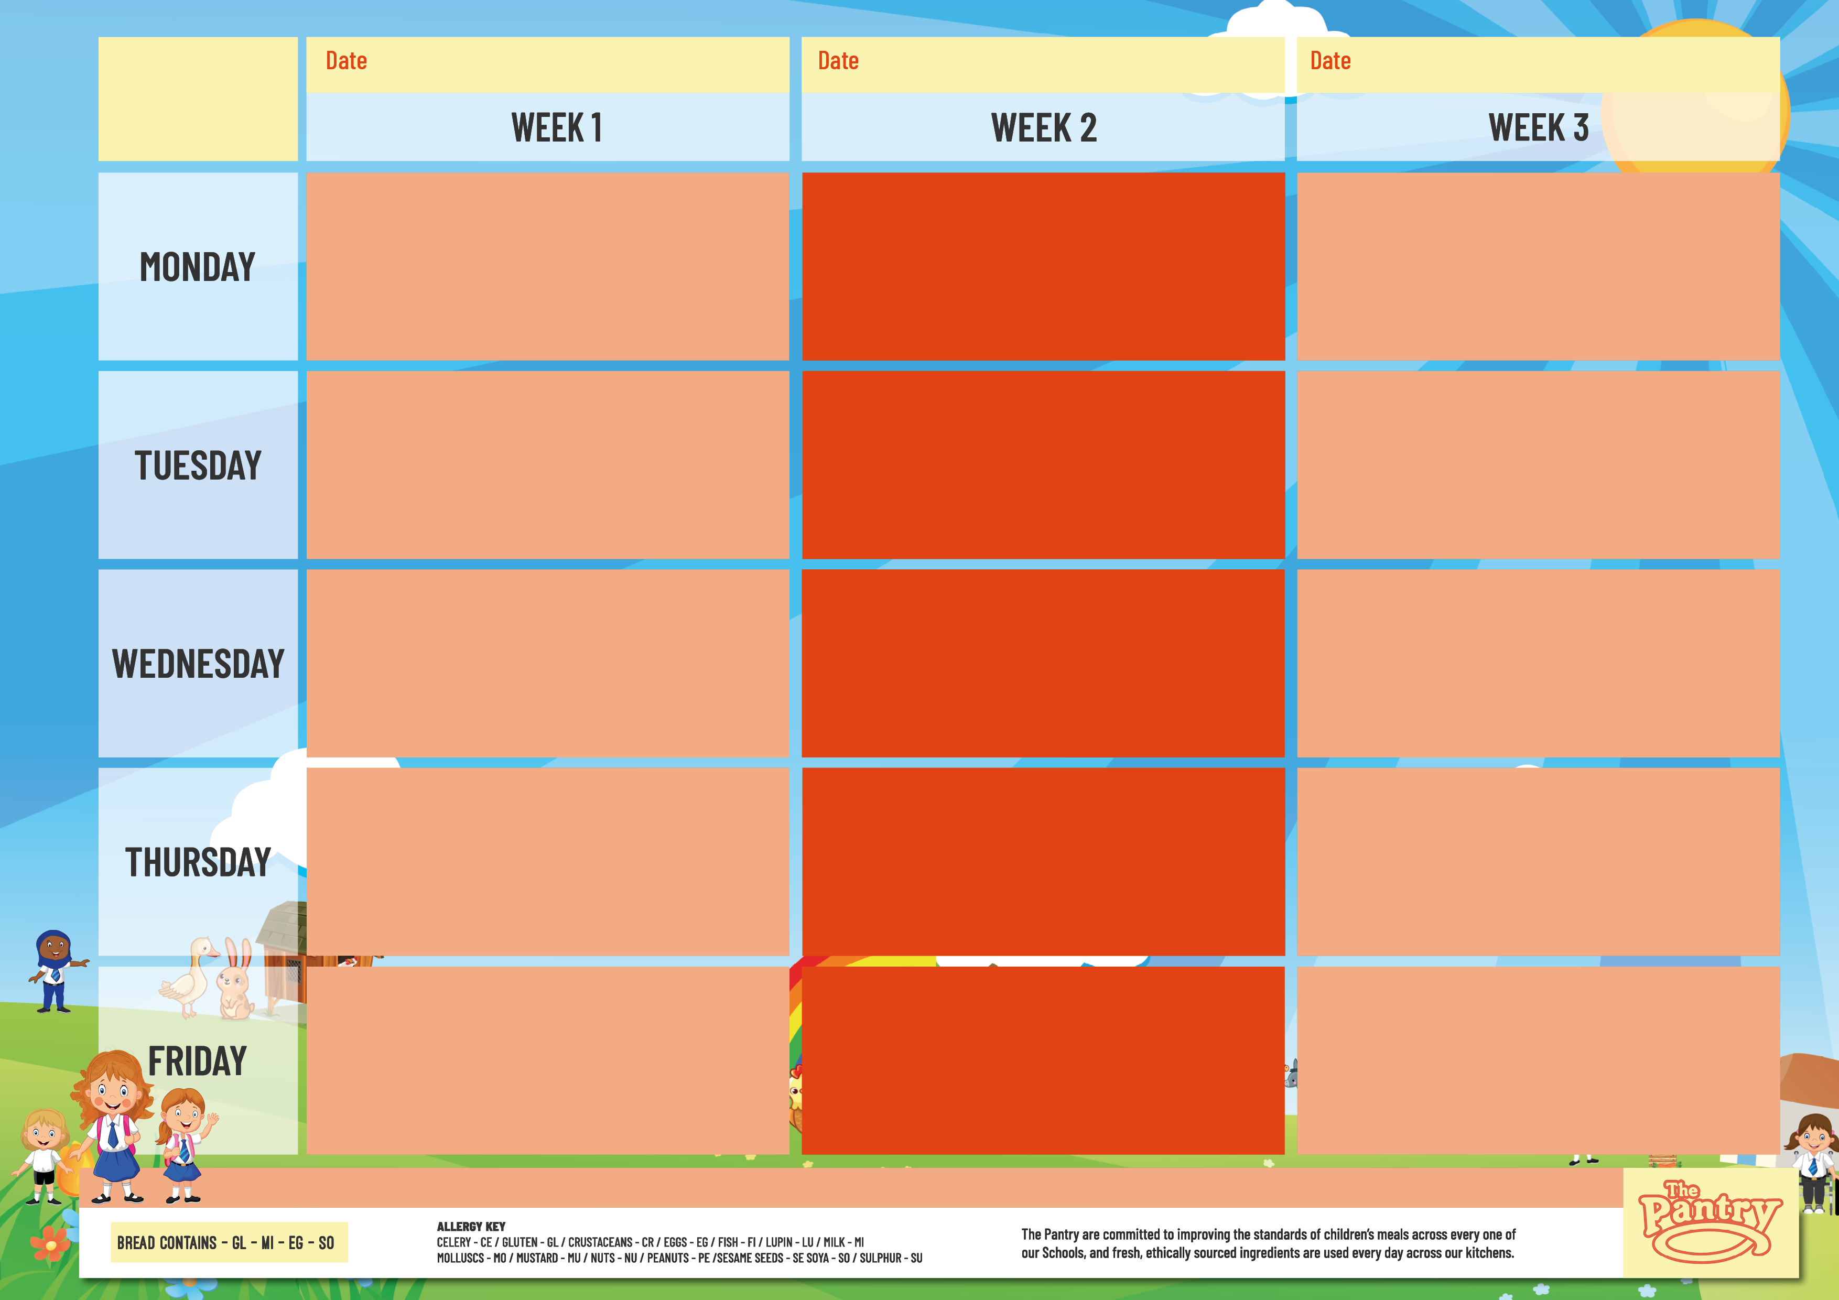
EMMANUEL
31st Aug, 21st Sep, 12th Oct, 2nd Nov, 23rd Nov,
14th Dec, 4th Jan, 25th Jan, 15th Feb
7th Sep, 28th Sep, 19th Oct, 9th Nov,
30th Nov, 21st Dec, 11th Jan, 1st Feb, 22nd Feb
14th Sep, 5th Oct, 26th Oct, 16th Nov
7th Dec, 28th Dec, 18th Jan, 8th Feb
Handmade Pepperoni pizza with Herby wedges (GL,MI)
Handmade Margherita pizza with Herby wedges (GL,MI)
Tomato Pasta (GL)
Jacket Potatoes – Cheese (MI), Beans or Tuna (FI) or Cheese & Beans (MI) or Cheese & Beans (MI)
Baguettes-Ham (GL,SO), Cheese (GL,MI,SO) or Tuna (GL,SO,FI)
Ice Cream (MI)
Classic Mac n cheese (GL,MI)
Cheesy Baked Bean Quesadilla (GL,MI)
Tomato Pasta (GL)
Jacket Potatoes – Cheese (MI), Beans or Tuna (FI) or Cheese & Beans (MI)
Baguettes-Ham (GL,SO), Cheese (GL,MI,SO) or Tuna (GL,SO,FI)
Millies Style Vanilla cookie (MI)
Handmade Margherita pizza with Seasoned Wedges (GL,MI)
Pasta Primavera (GL,MI)
Tomato Pasta (GL)
Jacket Potatoes – Cheese (MI), Beans or Tuna (FI) or Cheese & Beans (MI)
Baguettes-Ham (GL,SO), Cheese (GL,MI,SO) or Tuna (GL,SO,FI)
Apple & Raisin Biscuit (GL)
Chicken Meatballs with Tomato & Basil Sauce & Rice
Vegetable Biryani (GL) with carrot & Raisin Salad
Tomato Pasta (GL)
Jacket Potatoes – Cheese (MI), Beans or Tuna (FI) or Cheese & Beans (MI)
Baguettes-Ham (GL,SO), Cheese (GL,MI,SO) or Tuna (GL,SO,FI)
Creamy rice pudding with fruit sauce (MI)
Mild Sweet chilli beef & Golden Rice Wrap (GL)
Mild Sweet Chilli Vegetable & Golden Rice Wrap (GL)
Tomato Pasta (GL)
Jacket Potatoes – Cheese (MI), Beans or Tuna (FI) or Cheese & Beans (MI)
Baguettes-Ham (GL,SO), Cheese (GL,MI,SO) or Tuna (GL,SO,FI)
Apple crumble cake & Custard (GL,MI)
Gentle Chicken Korma with Steamed rice
Gentle Vegetable Dahl (GL) with Steamed rice
Tomato Pasta (GL)
Jacket Potatoes – Cheese (MI), Beans or Tuna (FI) or Cheese & Beans (MI)
Baguettes-Ham (GL,SO), Cheese (GL,MI,SO) or Tuna (GL,SO,FI)
Spiced Banana Bread & Custard (GL,MI)
Roast Chicken Breast with Potatoes & Gravy (SU)
Roasted Vegetable Loaf with Potatoes & Gravy (GL,SU)
Tomato Pasta (GL)
Jacket Potatoes – Cheese (MI), Beans or Tuna (FI) or Cheese & Beans (MI)
Baguettes-Ham (GL,SO), Cheese (GL,MI,SO) or Tuna (GL,SO,FI)
Super Oaty Flapjack (GL)
Sausage & Mash with Gravy (GL,MI)
Vegetarian Sausage & Mash with Gravy (GL,MI)
Tomato Pasta (GL)
Jacket Potatoes – Cheese (MI), Beans or Tuna (FI) or Cheese & Beans (MI)
Baguettes-Ham (GL,SO), Cheese (GL,MI,SO) or Tuna (GL,SO,FI)
Iced Sprinkle Sponge (GL)
Roast Gammon with Potatoes & Gravy (SU)
Vegetable Cottage Pie
Tomato Pasta (GL)
Jacket Potatoes – Cheese (MI), Beans or Tuna (FI) or Cheese & Beans (MI)
Baguettes-Ham (GL,SO), Cheese (GL,MI,SO) or Tuna (GL,SO,FI)
Fruity Shortbread (GL)
All Day Breakfast with Baked Beans (GL,SO,SU)
Vegan All Day Breakfast with Baked Beans (GL,SO)
Tomato Pasta (GL)
Jacket Potatoes – Cheese (MI), Beans or Tuna (FI) or Cheese & Beans (MI)
Baguettes-Ham (GL,SO), Cheese (GL,MI,SO) or Tuna (GL,SO,FI)
Vegan Fruit Jelly
Creamy Salmon Tortellini (GL,MI,FI)
Handmade Margherita Pizza with Parika Wedges (GL,MI)
Tomato Pasta (GL)
Jacket Potatoes – Cheese (MI), Beans or Tuna (FI) or Cheese & Beans (MI)
Baguettes-Ham (GL,SO,), Cheese (GL,MI,SO) or Tuna (GL,SO,FI)
Handmade Oaty Biscuit (GL)
The Pantry’s Own Recipe Beef Bolognaise Pasta bake (GL)
The Pantry’s Own Vegetable Bolognaise bake (GL)
Tomato Pasta (GL)
Jacket Potatoes – Cheese (MI), Beans or Tuna (FI) or Cheese & Beans (MI)
Baguettes-Ham (GL,SO), Cheese (GL,MI,SO) or Tuna (GL,SO,FI)
Lemon Drizzle Cake (GL,SU)
Breaded Fish fingers with Chips & Beans (GL,FI)
Veggie fingers with Chips & Beans (GL)
Tomato Pasta (GL)
Jacket Potatoes – Cheese (MI), Beans or Tuna (FI) or Cheese & Beans (MI)
Baguettes-Ham (GL,SO), Cheese (GL,MI,SO) or Tuna (GL,SO,FI)
Dessert Bar (GL,MI,SU)
Crispy Chicken Nugget with Chips & Beans (GL)
Crispy Vegan nuggets with Chips & Beans (GL)
Tomato Pasta (GL)
Jacket Potatoes – Cheese (MI), Beans or Tuna (FI) or Cheese & Beans (MI)
Baguettes-Ham (GL,SO), Cheese (GL,MI,SO) or Tuna (GL,SO,FI)
Dessert Bar (GL,MI,SU)
Oven baked battered fish with Chips & Beans (GL,FI)
Handmade Cheese & Onion Pasty with Chips & Beans (GL.MI)
Tomato Pasta (GL)
Jacket Potatoes – Cheese (MI), Beans or Tuna (FI) or Cheese & Beans (MI)
Baguettes-Ham (GL,SO), Cheese (GL,MI,SO) or Tuna (GL,SO,FI)
Dessert Bar (GL,MI,SU)
VEGETABLES, SALAD, BREAD, AVAILABLE DAILY

